Slide 1
FutureCoal Comms Slide Deck

Slide 2

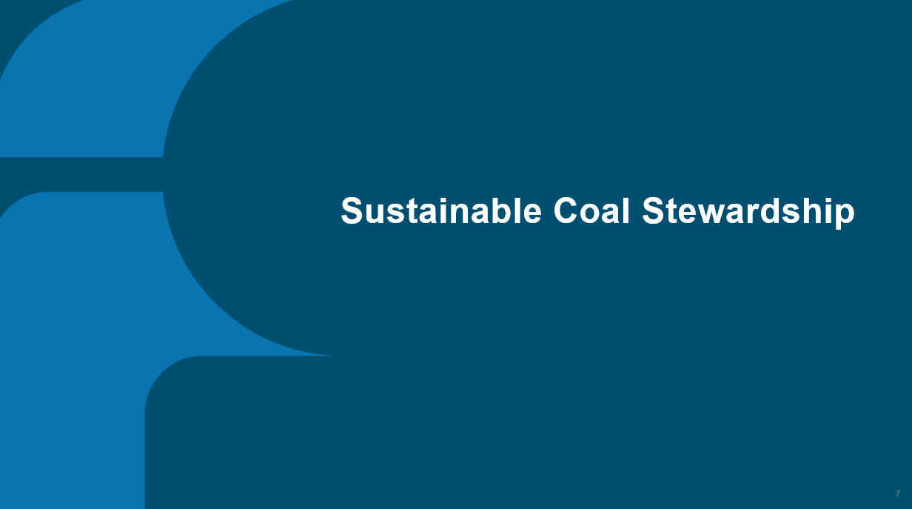





Contents

Slide 3
Who is FutureCoal?
3

Slide 4
FutureCoal
In November 2023, the WCA rebranded as ‘FutureCoal: The Global Alliance for Sustainable Coal’ after 38 years. FutureCoal opens new markets of collaboration and unites stakeholders across the coal and coal-allied sectors worldwide. Our mission is underpinned by the Sustainable Coal Stewardship (SCS) philosophy, which provides a pathway to maximise the value extracted from each tonne of coal. Value is determined and measured in both economic and environmental benefits.
Transformation to FutureCoal
4
3
New Coal
The global coal value chain is evolving rapidly to meet the world's changing demands. Through strategic deployment of coal abatement technologies, our Alliance are ushering in a new era of sustainability and innovation.
2
Coal’s New Strategy
The WCA realised it needed to be the guardian of coal's brand, leading to the creation of the Evolving Coal Strategy to mobilise the value chain and speak up on behalf of “Brand Coal”. We launched the Reputation Management Project with McCann to mobilise the coal value chain and advocate for "Brand Coal.” Together with the global branding agency, McCann, we agreed that the organisation needed to have a vision for the future and be that guiding north star. Our goal was to become a progressive organisation, safeguarding our legacy for centuries to come.
1
Reputational Damage
Before 2019, “Brand Coal” was marred, distrusted, and not seen as a participant in the clean agenda.
Notes:
On 20 November 2023, the World Coal Association rebranded to FutureCoal: The Global Alliance for Sustainable Coal.
FutureCoal is the world’s only multilateral, neutral, and progressive organisation representing the responsible coal value chain.

Slide 5
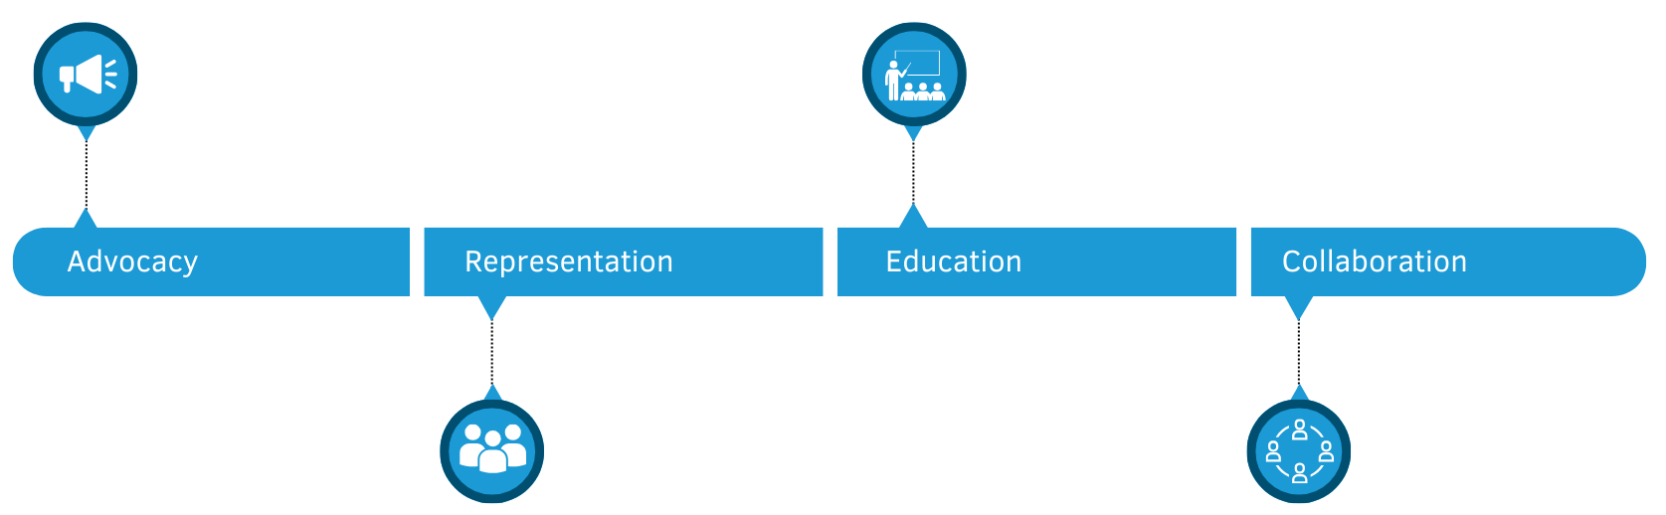
FutureCoal is A Progressive Organisation
FutureCoal stands as a unified voice, advocating for the interests of the responsible global coal value chain, ensuring equitable representation, transparency and fostering collaboration for sustainable coal practices.
FutureCoal educates on coal's critical role and its ongoing contribution to improving global lives and livelihoods. We recognise that, as part of an integrated coal value chain, we must support both national and international economic and environmental goals.
FutureCoal provides a robust and transparent global platform for collaboration, uniting stakeholders across the entire coal value chain. From thermal and metallurgical sectors to renewable supply chains and coal innovation, we foster cooperation among diverse industry players worldwide.
FutureCoal is the world’s only multi-lateral, neutral, and progressive organisation representing the entire coal value chain, including thermal, metallurgical, renewable supply chains and coal innovation sectors with corporate members and national industry partners based in major coal economies and markets.

Slide 6


Slide 7
Sustainable Coal Stewardship
7

Slide 8
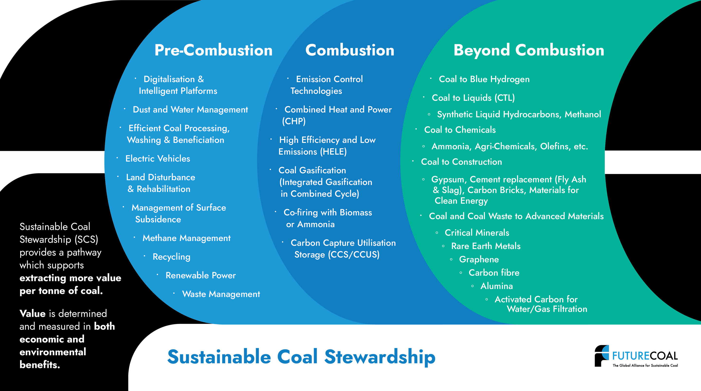
Pre-combustion offers key opportunities for emission reduction in the coal value chain, including efficient mining, digitalisation, waste management, renewable energy integration, and land restoration.

Slide 9
Beyond combustion is our vision
of the novel business opportunities that transform coal into high-value products. These include Coal-to-Liquids (CTL), synthetic liquid hydrocarbons, hydrogen, methanol, steel, cement, critical minerals for our
digitised and electrified future, and
advanced materials like graphene
and carbon fibre.
During combustion, advanced technologies like carbon capture and storage (CCS), high-efficiency low-emissions (HELE) systems, and carbon-neutral fuel co-firing achieve up to 99% emissions reduction, revolutionising energy production.

Slide 10
Beyond combustion is our vision of the novel business opportunities that transform coal into high-value products. These include Coal-to-Liquids (CTL), synthetic liquid hydrocarbons, hydrogen, methanol, steel, cement, critical minerals for our digitised and electrified future, and advanced materials like graphene and carbon fibre.

Slide 11
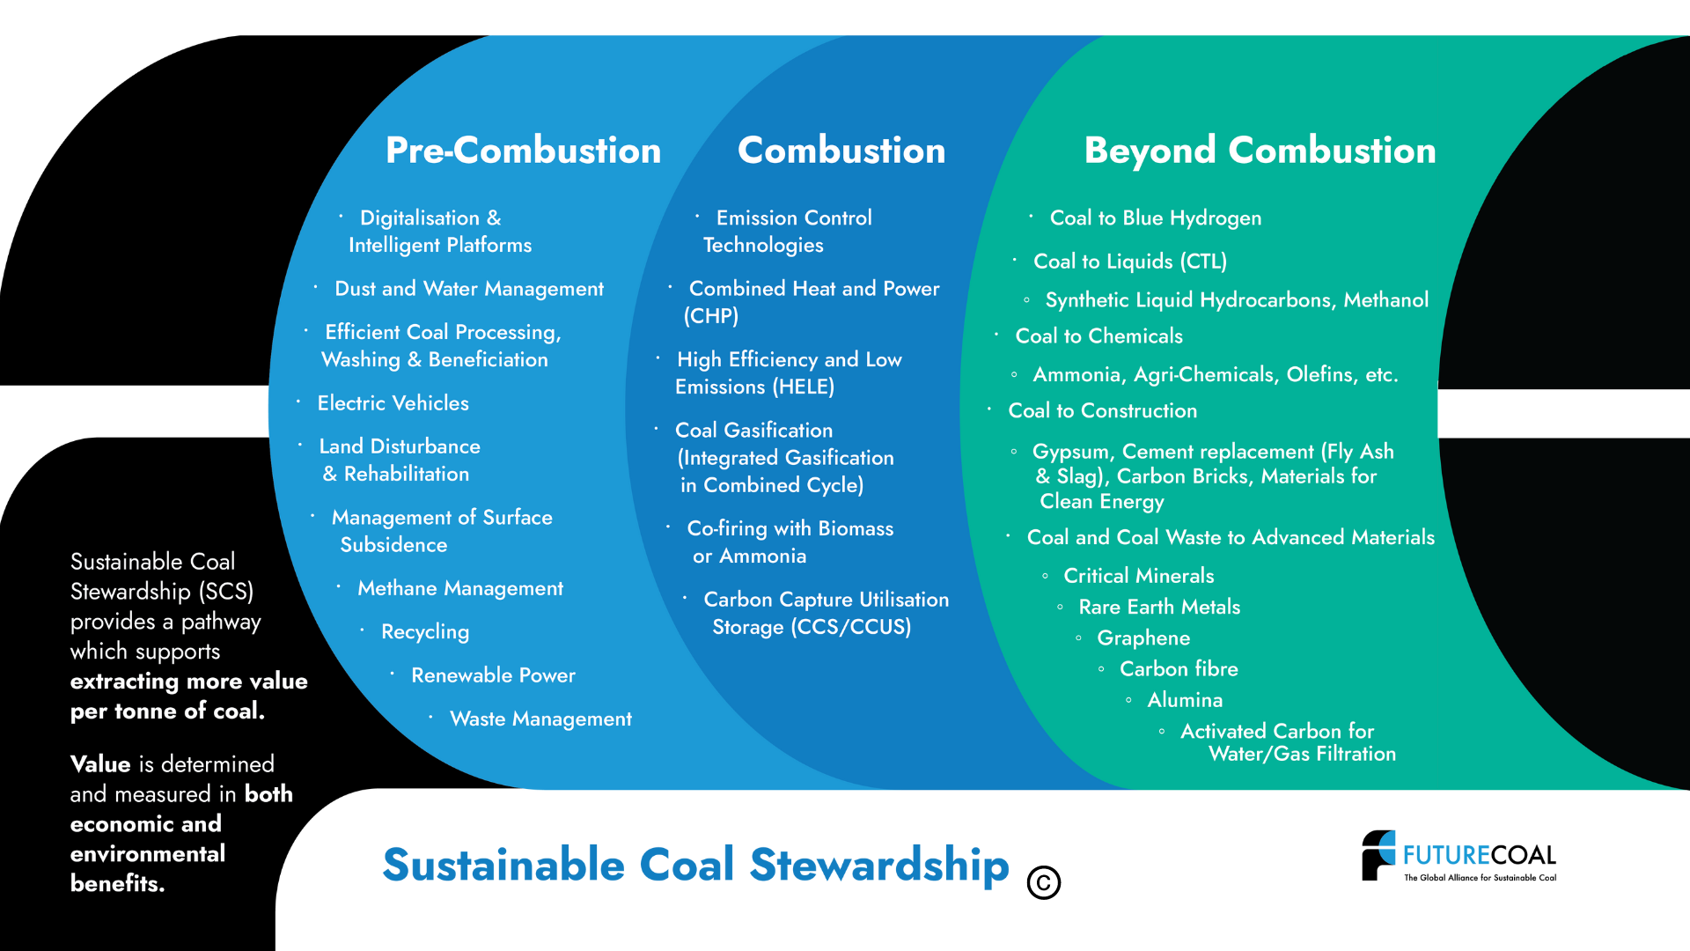

Slide 12


Slide 13
Messages on Pre-Combustion
13

Slide 14
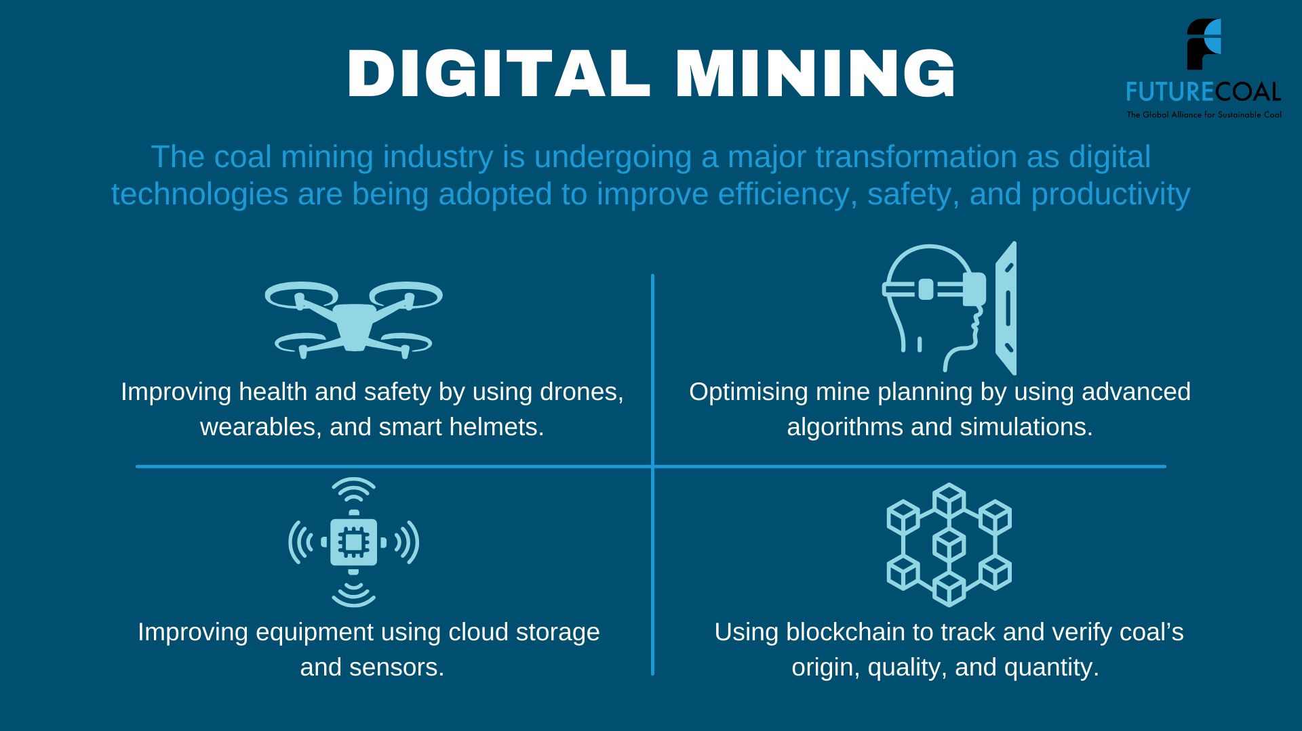

Slide 15
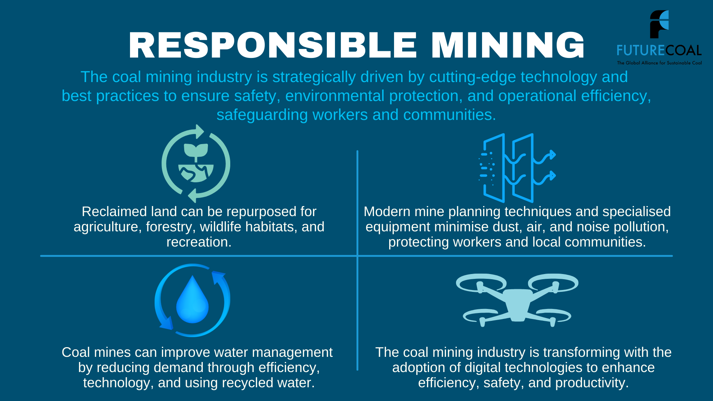

Slide 16
Messages on Combustion
16

Slide 17


Slide 18
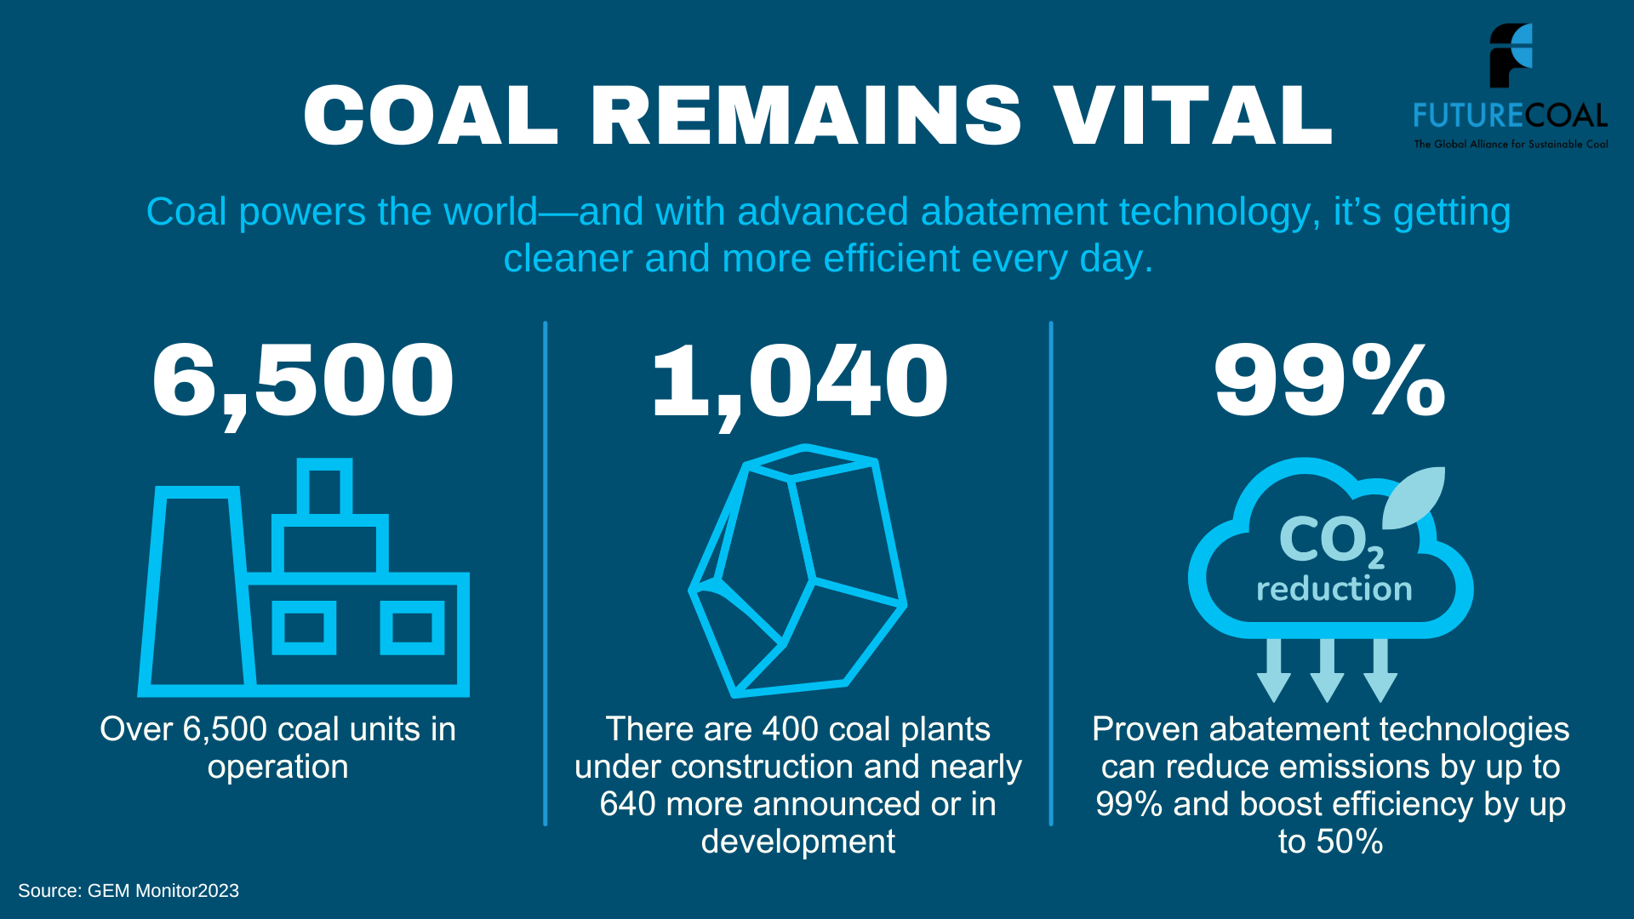

Slide 19

99% Abated
Coal abatement technologies, guided by FutureCoal’s Sustainable Coal Stewardship framework, can capture up to 99% of emissions, efficiently supporting power and heat utilities while promoting a responsible coal future.

Slide 20

Ultra-supercritical plants would save
2 billion tonnes of CO2 over 30 years.
Upgrading all subcritical coal plants to ultra-supercritical would save 2 billion tonnes of CO2 over 30 years.
Removing 2 billion tonnes of CO2 is equivalent to taking 111 million cars off the road.

Slide 21
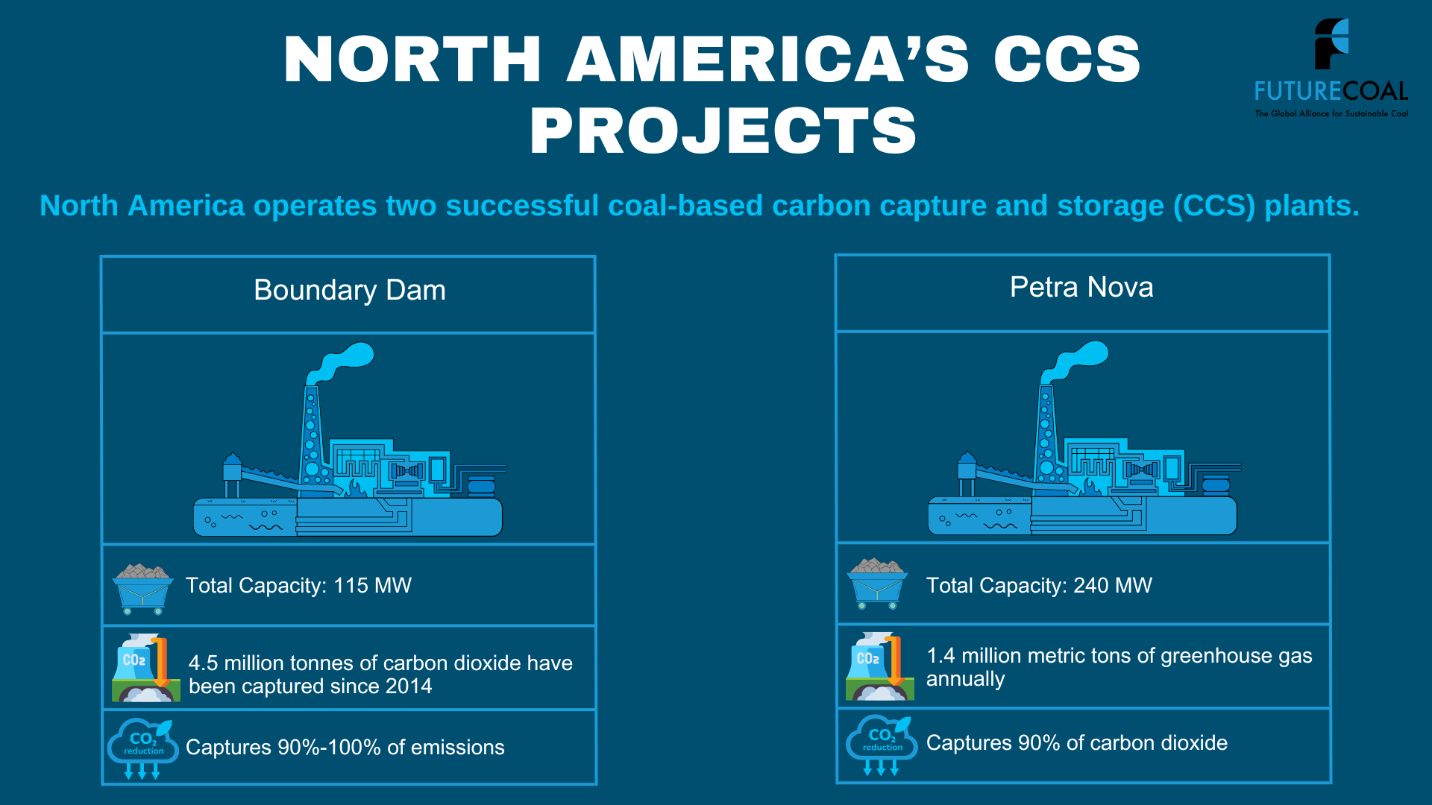

Slide 22
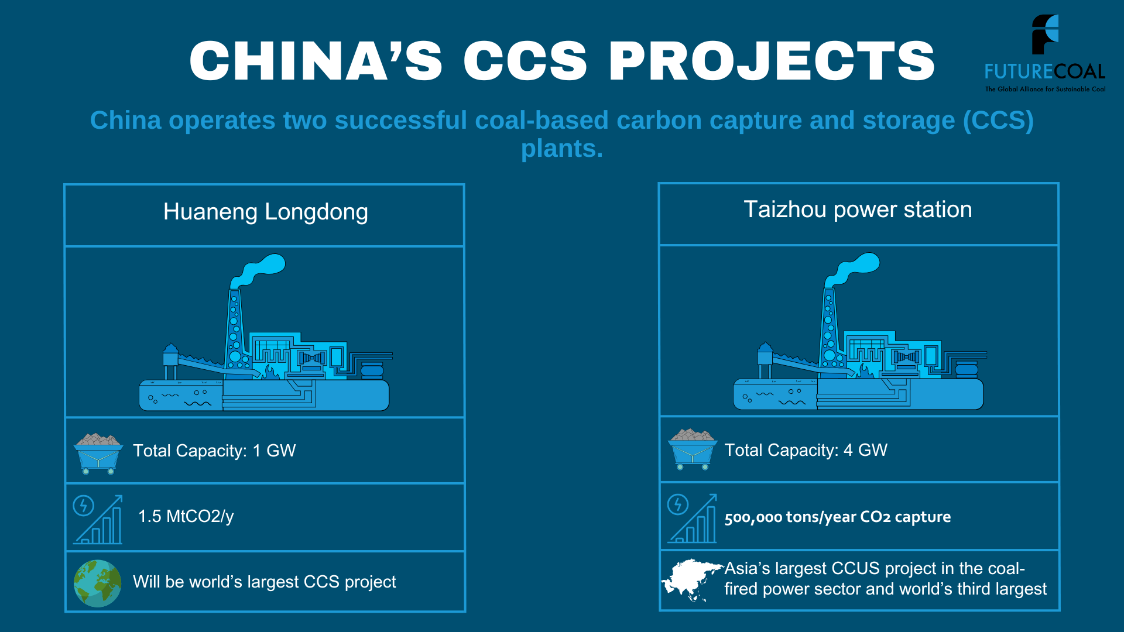

Slide 23
Messages on Beyond Combustion
23

Slide 24
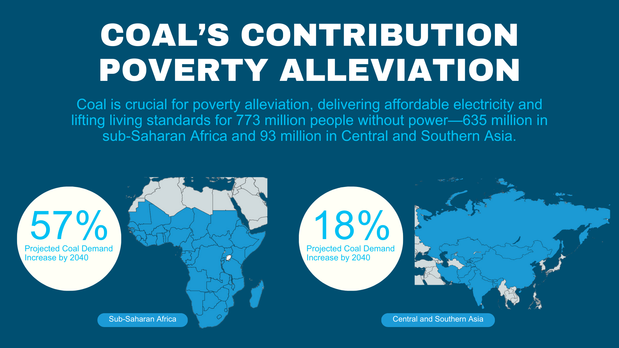

Slide 25
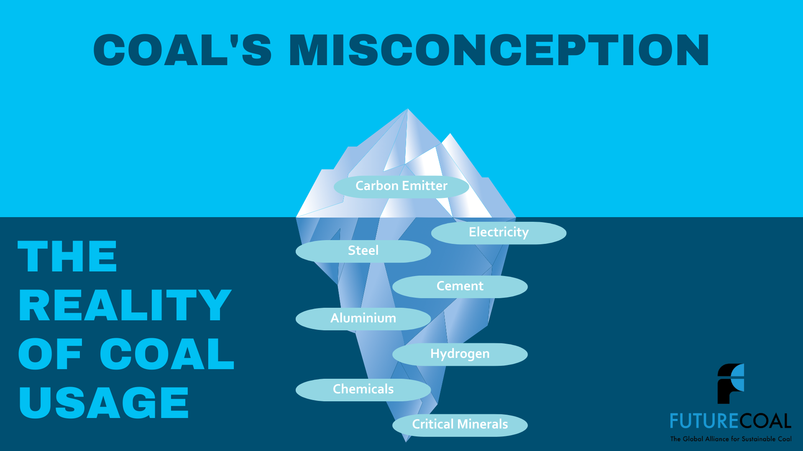

Slide 26
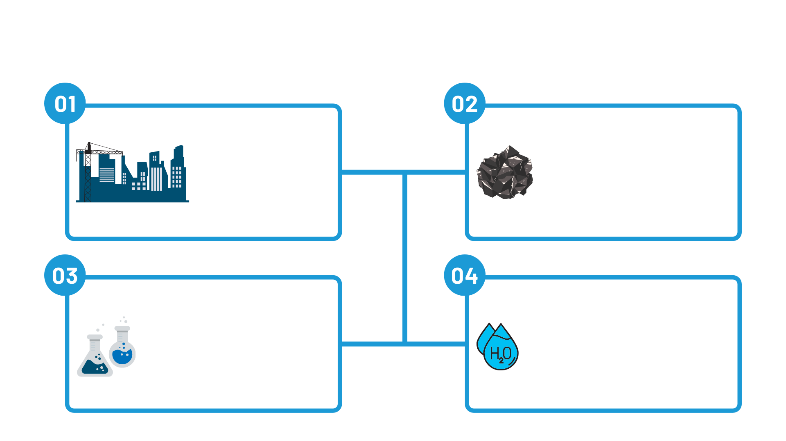

The coal ecosystem is vast, globally integrated, and—under the Sustainable Coal Stewardship framework—plays a crucial role in:
Coal contains essential heavy metals vital for modern technologies, including cobalt, copper, iron, lead, silver, nickel, and zinc, crucial for renewable energy, electric vehicles, aerospace, defence, and healthcare.
Coal is vital for steel, cement, aluminium, and renewable energy infrastructure, laying the foundation for modern society.
Coal-to-chemicals is the most cost-effective method for manufacturing various chemicals, leveraging the abundance and affordability of coal, as well as the efficiency of the coal gasification process.
Coal can produce the cheapest form of clean hydrogen and reduce carbon emissions by up to 90%.

Slide 27
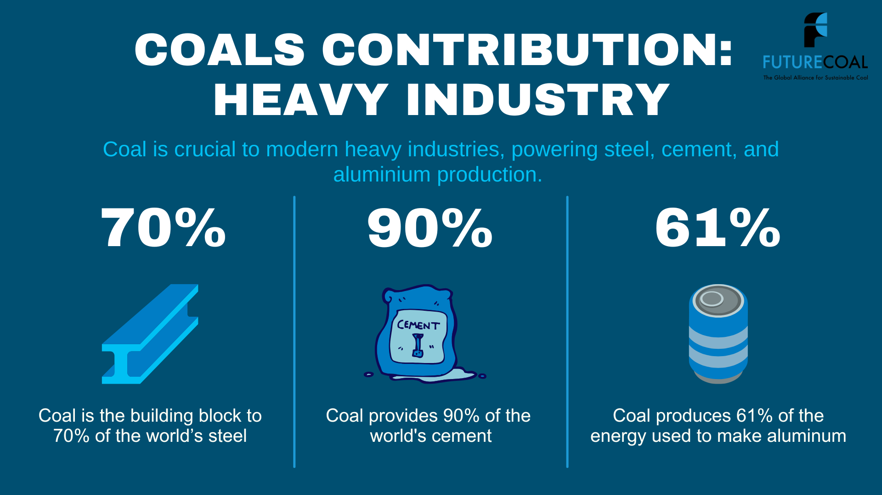

Slide 28
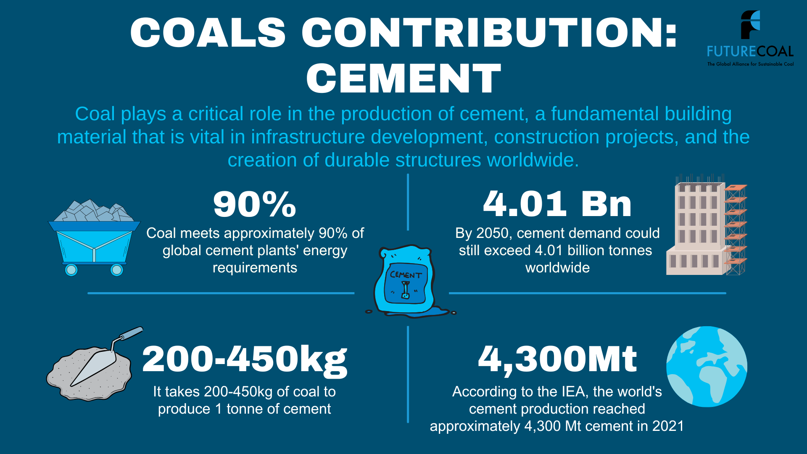

Slide 29
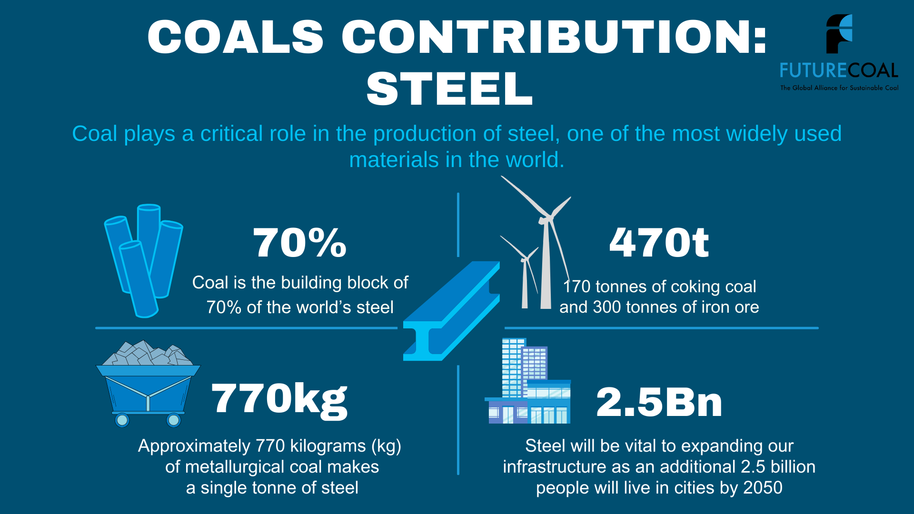

Slide 30
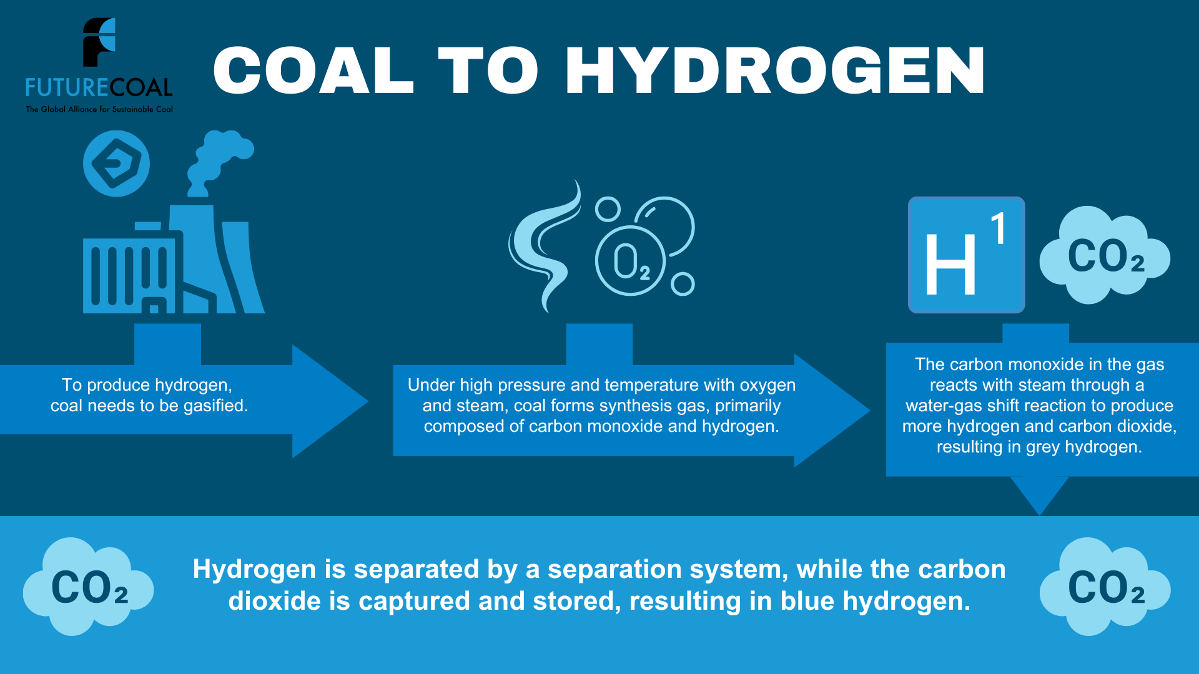

Slide 31
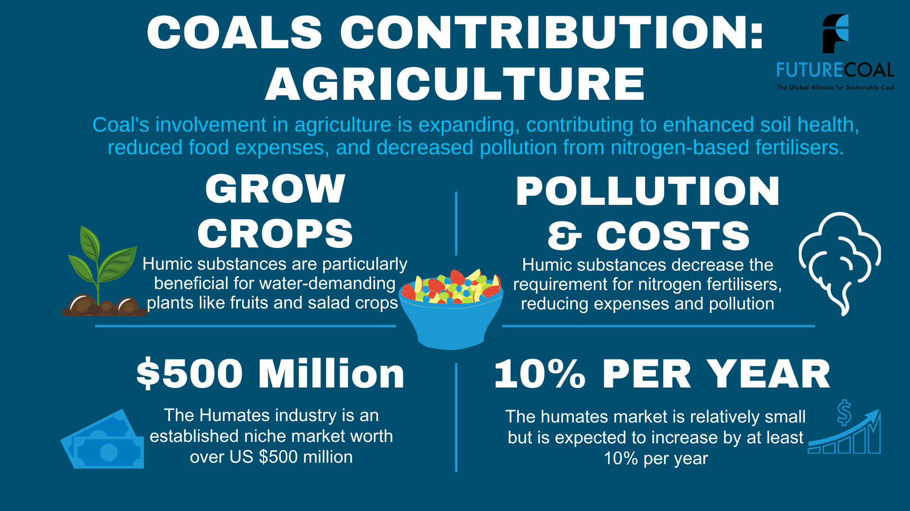

Slide 32
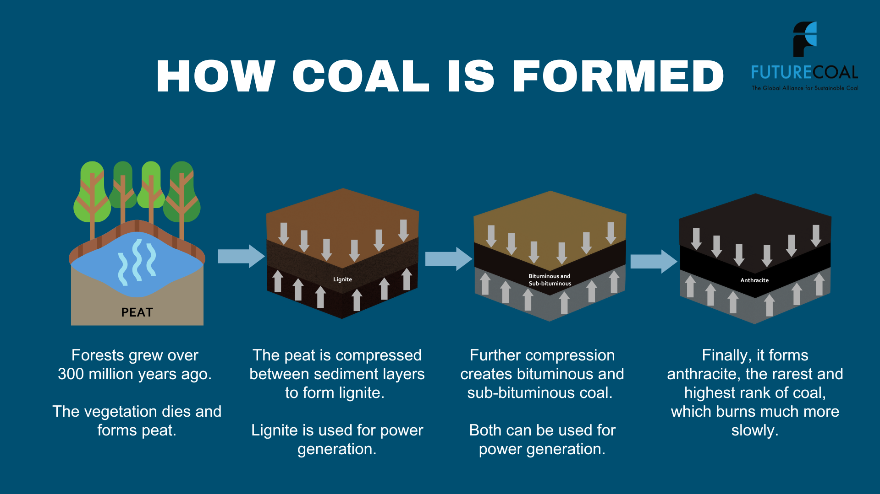
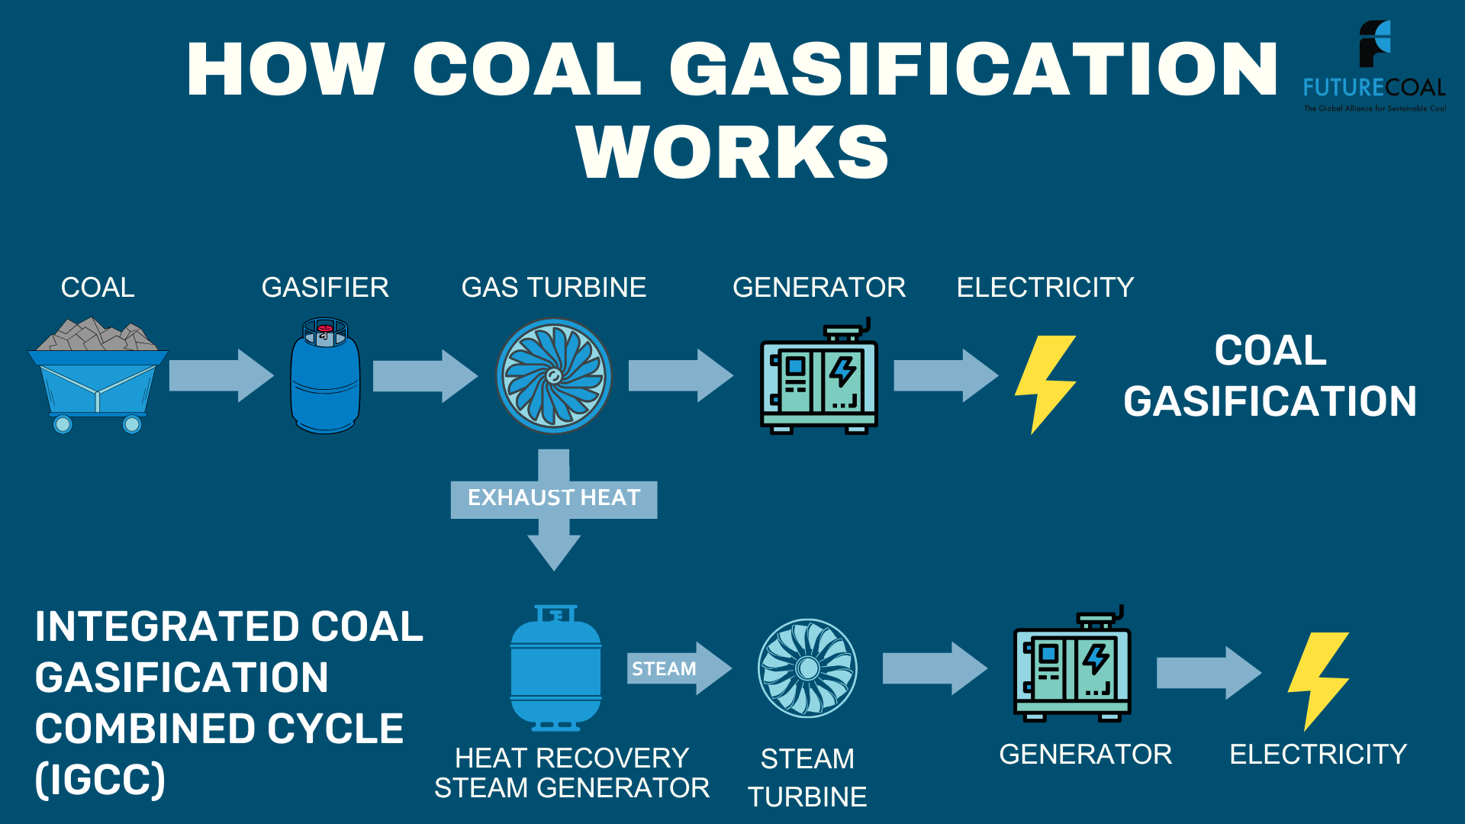
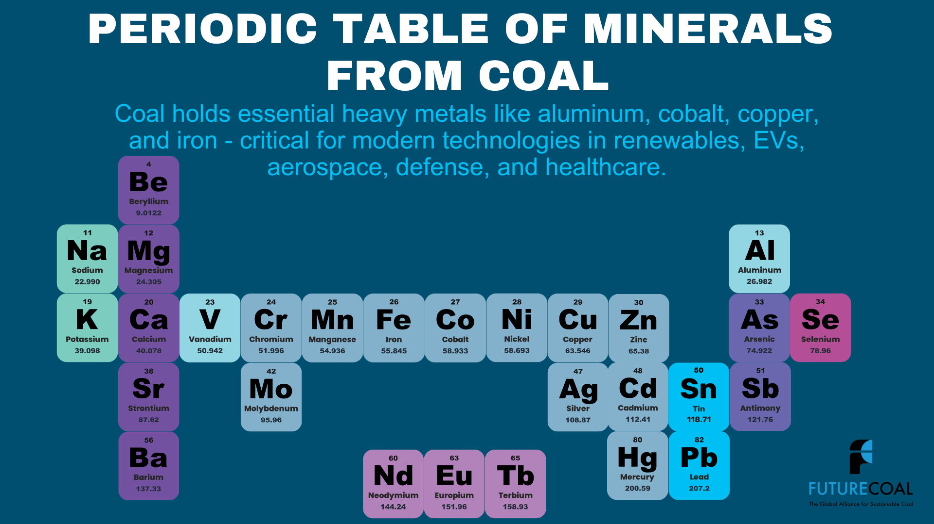

Slide 33
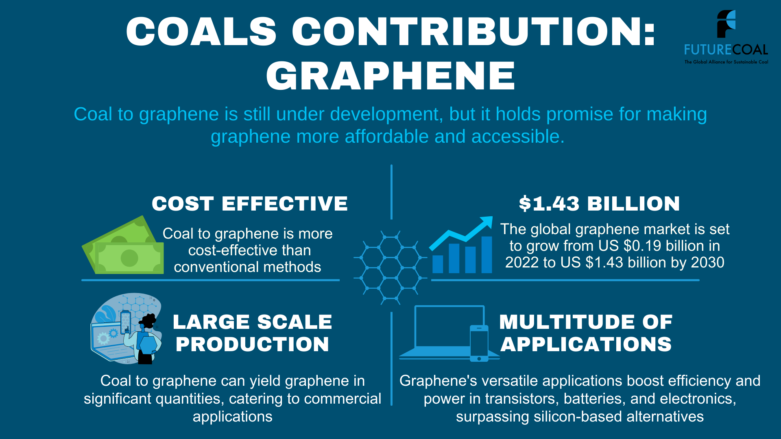

Slide 34


Slide 35
Messages on Coal and Energy
35

Slide 36
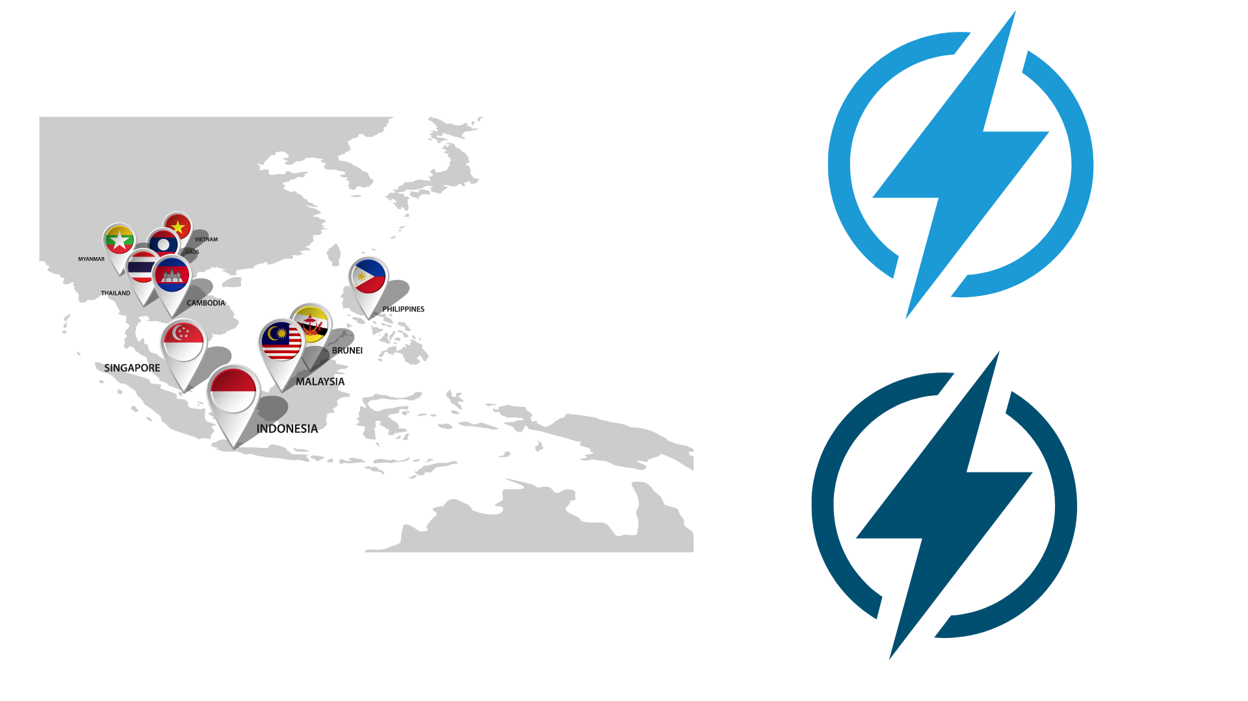
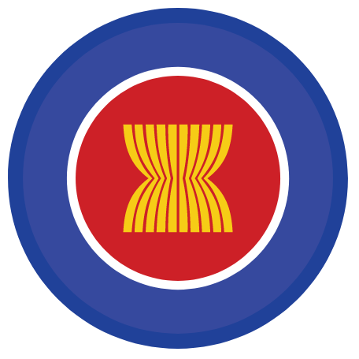
Coal Continues to Power the World
In 2023, coal was the leading source of electricity, accounting for an impressive 37%.
By 2030, coal is projected to maintain its dominance as the largest single source of electricity, accounting for 27% of the total.
By 2030, coal is forecasted to represent 35% of the energy mix in Southeast Asia.

Slide 37
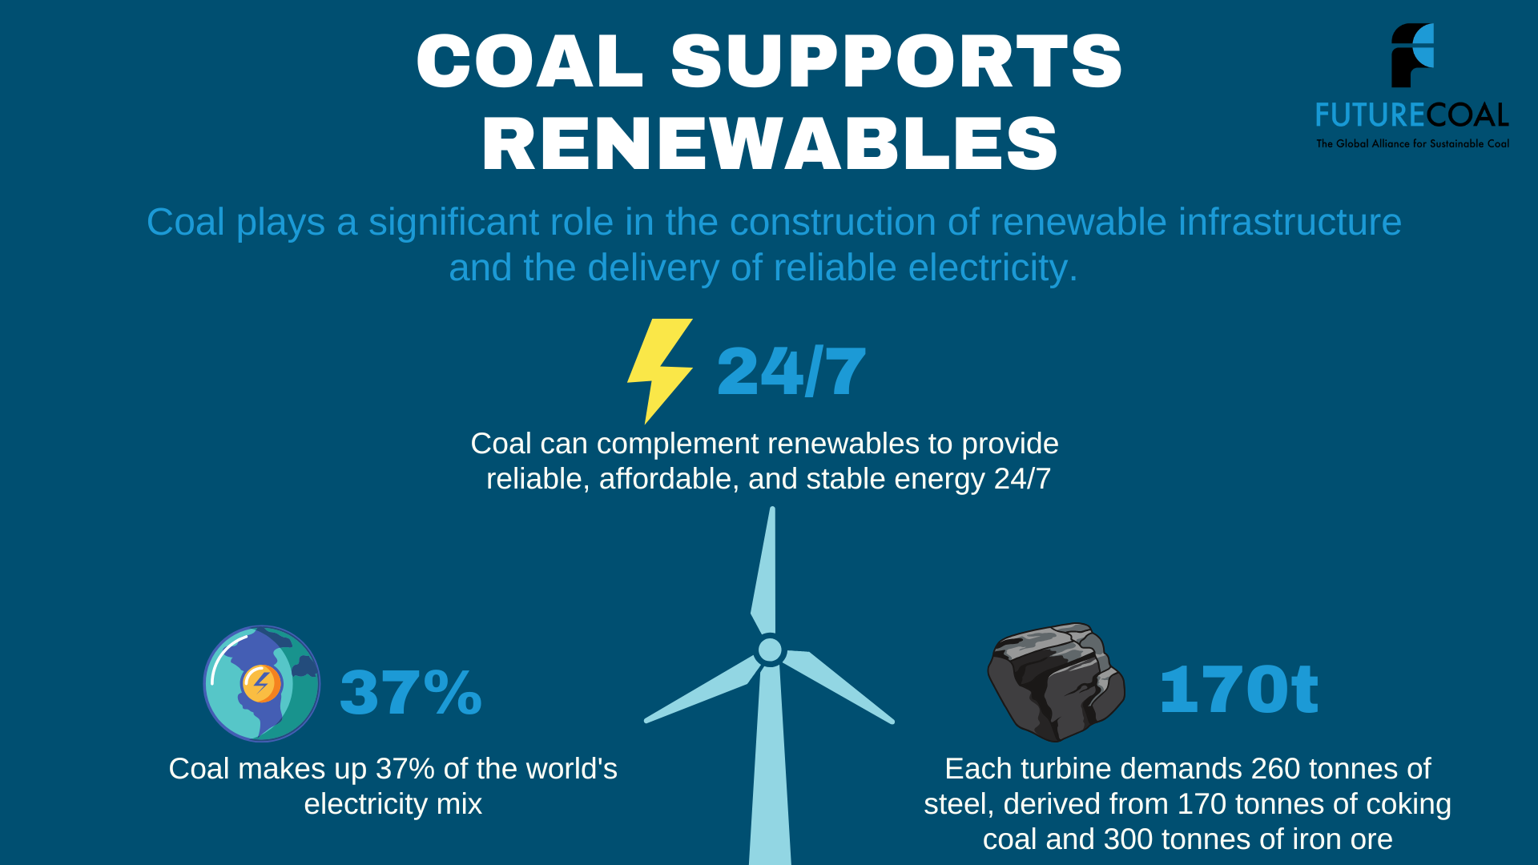

Slide 38
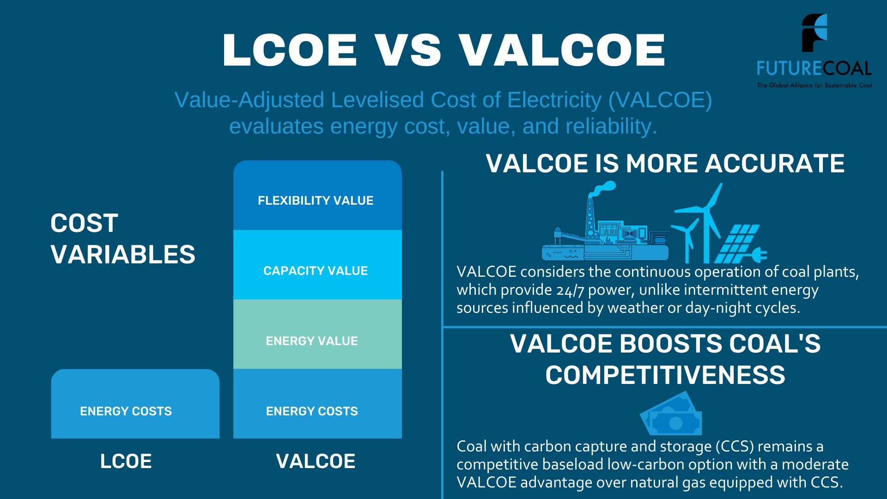

Slide 39
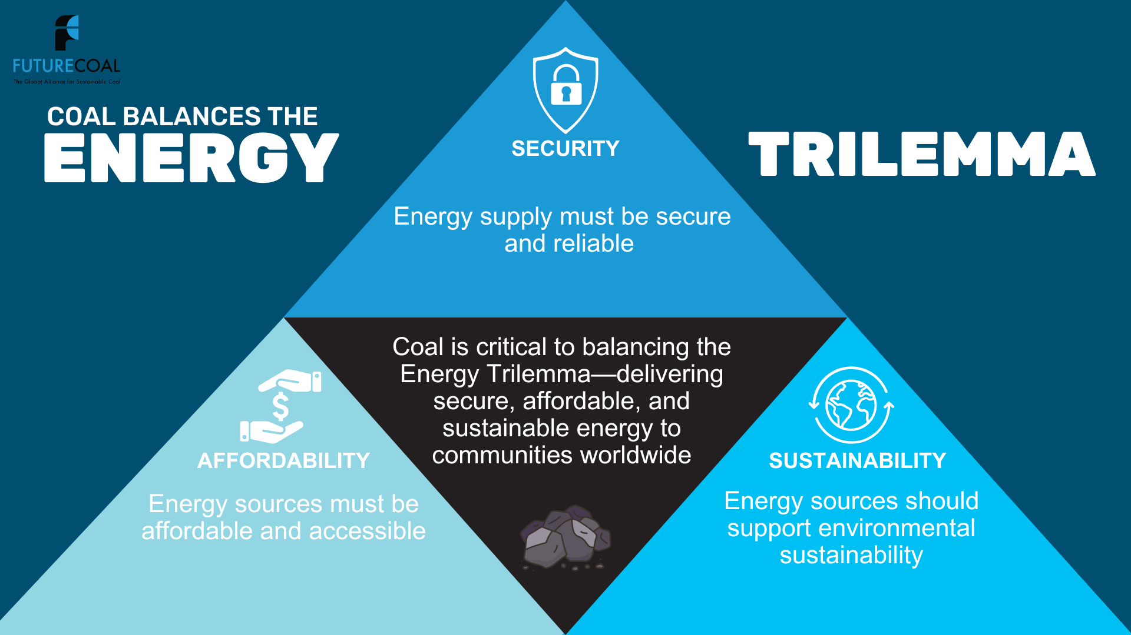

Slide 40
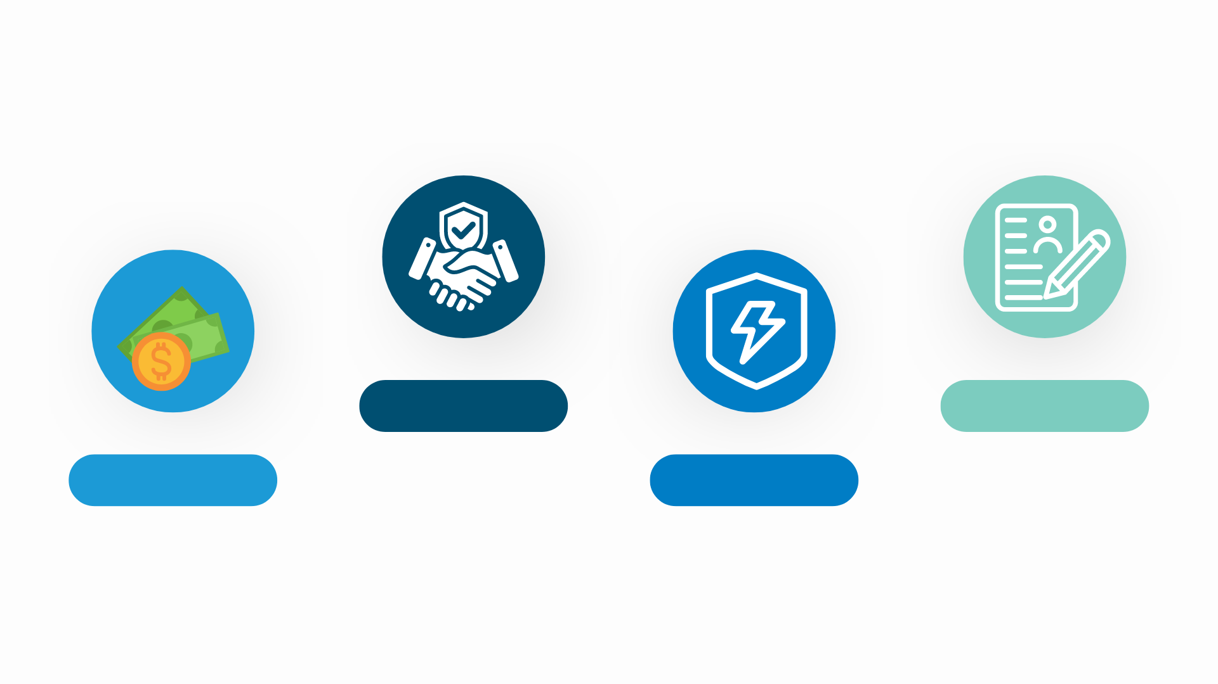
Coal Supports Nations
Reliability
Job Creation
The reliable and consistent power output of coal-fired plants addresses the need for stable energy access, supporting industrialisation and economic development.
Coal mining and associated industries provide significant employment opportunities, contributing to job creation and economic growth in developing nations.
Affordability
Energy Security
Coal remains a cost-effective energy source, crucial for developing nations seeking affordable solutions to meet their growing energy demands.
Developing nations often have nascent energy infrastructures. Coal provides a domestic energy source, enhancing energy security by reducing dependence on external suppliers.

Slide 41

Largest Single Source
Projections by the International Energy Agency (IEA) indicate that coal will continue to be the world's largest single source of electricity by 2040.
2040
Coal Demand Will Continue to Increase
The IEA projects that coal demand in sub-Saharan Africa will increase by 57% between 2020 and 2040, and that coal demand in Central and Southern Asia will increase by 18% over the same period. (IEA World Energy Outlook 2023).
Coal will continue to be important
Coal Capacity in ASEAN Projected to Increase
By 2040, coal capacity in the ASEAN is projected to reach 295 GW, accounting for 49% of power generation capacity.

Slide 42
Media Messages
42

Slide 43

Coal Can Evolve and Lead the Way to a Sustainable Future
Coal is a legitimate energy source that can be abated by up to 99%, and it must be part of the conversation about our energy future.
Instead of concentrating on coal's elimination, particularly in coal-rich nations, countries should prioritise an energy addition approach strategy.
This strategy acknowledges coal's potential to reduce emissions while supporting economic growth and enhancing energy security.
Our Sustainable Coal Stewardship (SCS) map serves as a blueprint for existing and proven abatement technologies.
This includes high-efficiency, low-emissions (HELE) plants, coal gasification, CCS, co-fire with biomass.
These innovations illustrate that coal can sustainably meet today’s energy demands while contributing to a balanced energy mix.
Neglecting coal’s role in our energy landscape threatens the communities and industries that depend on it. FutureCoal advocates for continued investment in coal abatement technologies, ensuring that coal plays a responsible and transformative role in our energy strategy.
A sustainable future requires embracing the potential of abated coal as a vital component of energy addition.

Slide 44

Coal Cannot Simply Be Replaced
We must recognise coal's total contributions instead of seeking its elimination. Coal supports modern society in many ways, extending far beyond energy.
Coal is vital for producing fertilisers essential for global food security and manufacturing steel and cement—foundational elements of infrastructure.
Additionally, coal plays a crucial role in emerging hydrogen technologies, facilitating cleaner energy solutions, and serves as a source of critical minerals for innovative technologies.
Through our Sustainable Coal Stewardship (SCS) map, we promote responsible coal use and innovative abatement technologies that can significantly reduce emissions while maintaining coal's essential role in these industries.
Therefore, coal cannot be simply replaced—it must transform. Sustainable Coal Stewardship is the pathway to achieving that transformation while addressing environmental challenges.

Slide 45

Responsible Investment Must Be Inclusive
Responsible investment must be inclusive, levelling the playing field for all fuels and technologies, including coal. Dismissing coal outright ignores the realities faced by emerging and developing nations at different starting points that depend on it for affordable, reliable energy and its potential to drive economic growth beyond combustion.
Our Sustainable Coal Stewardship (SCS) blueprint illustrates how coal can be a key component of a responsible investment strategy. SCS promotes innovative technologies that reduce emissions, demonstrating that coal can significantly contribute to a sustainable energy future.
Furthermore, it highlights how coal’s total contribution can be harnessed to support various industries, driving economic growth and job creation.
Responsible investment should be inclusive and forward-thinking.
By backing coal and promoting Sustainable Coal Stewardship, we foster a more equitable and sustainable future for all nations, regardless of their starting point.

Slide 46


United for Coal’s Long-Term Future
Global coal reserves (~1 trillion tonnes) and increasing energy demand highlights its ongoing relevance. Additionally, coal plays a vital role in producing critical minerals, infrastructure, and fertilizers for agriculture, key components for a thriving economy.
Sustainable Coal Stewardship (SCS) serves as a transformative roadmap for the modernisation of the coal industry.
We must unite as a global value chain to educate and drive this transformation.
The reality is that our global community—whether they realise it or not—depends on coal in various forms. Therefore, it is imperative to set aside our differences and collaborate to meet the economic and environmental expectations of the world.

Slide 47



Chris Demetriou
Head of Global Cmunications
cdemetriou@futurecoal.org
www.futurecoal.org
FutureCoal on LinkedIn
FutureCoal on YouTube
Notes:
Thank you again for the invitation. These opportunities are incredibly important as they unite the entire value chain, enabling us to exchange knowledge, innovate, and drive progress together.
I'm excited about collaborating closely with your organization and its members in the future.
Let's make a meaningful impact together!

